Slide 1

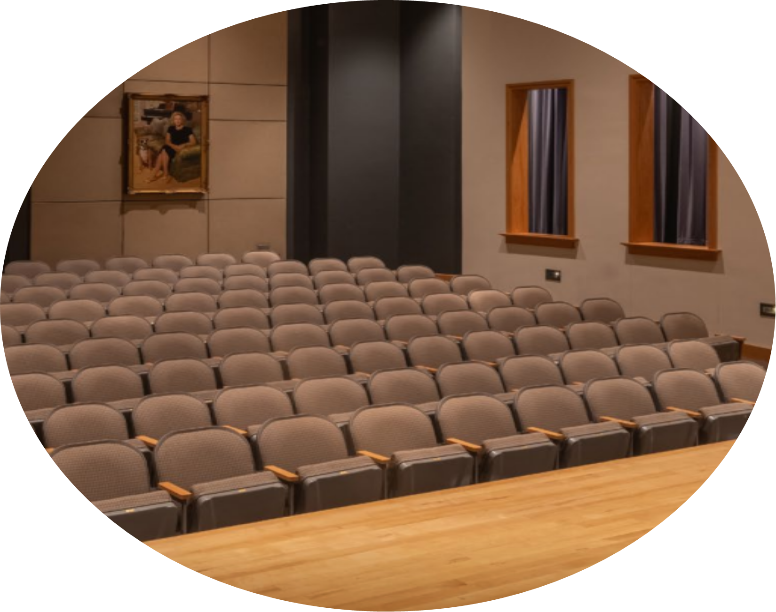
Venue Access Grants
Information Session
ArtsAndScience.org
Tate Hall | CPCC

Slide 2
Arts & Culture Plan
The Venue Access grant was inspired by the City of Charlotte Arts & Culture Plan. This proposal outlined a vision to sustain and grow the arts and culture sector in the Charlotte-Mecklenburg area. This funding opportunity aligns with the strategic priorities to Connected Community and promoting Economic Opportunities. Successful proposals will demonstrate how their projects contribute to the broader county goals, such as:
1
2
Fostering access to physical, social, and informational resources for all community members.
Providing economic opportunities for individuals and businesses.
3
Building a community where all people can thrive and be well.

Slide 3
Venue Access Grant Timeline
Application opens: Wednesday, January 14th, 2026, at noon
Supporting programming taking place September 1st, 2025 through December 31st , 2026
Application Deadline: Applications will be accepted on a rolling basis until May 4th, 2026 or until funds are exhausted.
Please submit draft applications to grants@artsandscience.org.
Award or Declination Notification: TBD. Applicants may expect notification approximately 4 weeks after application receipt.

Slide 4
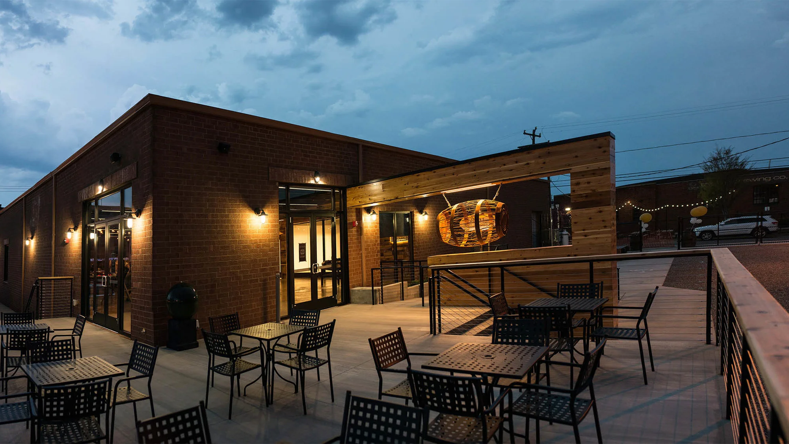
The Barrel Room at Triple C Brewing
2832 Griffith St, Charlotte, NC 28203

Slide 5
Who can apply?
Creative Individuals
Nonprofits
Must operate as a sole proprietorship or LLC
Book of work must be focused on arts, science, history, or heritage programming.
Must be 18 years of age, reside and/or have an artistic business/studio in, and primarily serve Mecklenburg County.
Must have a professional portfolio that includes published or publicly displayed works.
Must have a minimum of three years of income history from their artistry as a sole proprietor or LLC to demonstrate professional artist tenure.
must have produced a similar event previously within Mecklenburg County, as this evidence and venue reference is needed as part of the application.
Must be a 501(c)(3) public charity
Primary mission must be focused on arts, science, history, or heritage programming.
Must be located in and primarily serve Mecklenburg County.
Must have a minimum of two years of operational history.
Must have operating budget of $1.25 million or less.
Creative Individuals and Nonprofits are encouraged to submit one application annually. Multiple performances that are a part of the same event can be funded (ex. three performances of the same show in one weekend).

Slide 6
Eligible Requests
Direct rental costs for publicly or privately owned venues located within Mecklenburg County.
Essential, directly associated venue-related fees (ex. technician support, cleaning fees, security) as outlined in the venue rental packet.
Parking costs for essential creative and administrative staff.
Events that directly engage the public through performances, exhibitions, workshops, lectures, or other cultural programming. This includes studio and/or dress rehearsal space leading up to a performance, if this is through the same venue of choice for the culminating event(s).
  Examples: 1) Rehearsing in a dance studio at CPCC for several days before performing in their Parr Center, 2) Holding a Thursday tech rehearsal at First United Methodist Church before a weekend of performances in the same venue, etc.
Can cover up to one month’s rent in a facility that is not your own, if that month includes a large, public-facing event for the applicant. Example: if an individual is already renting from Ascend or VAPA, this can subsidize one month’s rent if you hold an event at that facility during that time.
For this 2025-2026 grant cycle, our priority is offering subsidies for performance or event space.
Priority will be given to projects that demonstrate a clear strategy for making the event and venue accessible to diverse audiences, including those with disabilities.
For this 2025-2026 grant cycle, our priority is offering subsidies for performance or event space.

Slide 7
Ineligible Requests
General operating support/income.
Any catering, concessions, and private event costs (ex. A reception for donors, etc.) within the rental. These would need to be paid separately from this grant request.
Capital improvements or purchase of property or equipment.
Additional expenses needed to transform the space beyond what is listed in the venue’s rental packet.
Debt or dept reduction efforts.
Storage space.
Events cannot contain religious content or specifically serve only church membership, faculty/student body, or another exclusive group.
Projects that involve working with PreK-12 children during the school day.
booster clubs, parent-teacher organizations, and activity associations connected to a school are ineligible
organizations that do not have an arts, science, history or cultural focus in their mission statement are ineligible
Multi-year requests.
Political events for or against a political candidate, ballot measure, or bill.
Fundraising events or galas where the primary purpose is to raise funds for the applicant’s business rather than provide public cultural access.
Costs for staff salaries, artist fees, marketing, or production expenses not directly tied to the venue rental agreement.
Projects, productions, workshops, and/or programs that include obscene material. In general, obscene material is considered offensive or indecent, often involving sexual acts or nudity.
Private non-operating foundations.
Venues outside Mecklenburg County.
Applicants that have delinquent paperwork for a previously funded ASC grant are not eligible.
Notes:
(For point #4) For example, instead of spending funds to transform a space into a dance capacity, we encourage applicants to reach out to a venue already serving this art form with these resources available.

Slide 8
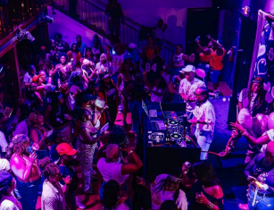
BEFORE APPLYING
The Long Room
1111 Central Avenue, Ste 230, Charlotte, NC, 28204

Slide 9
PAGE 3
Before Applying
Applicant(s) must reach out to an eligible venue previously approved by ASC.
  a. Inform the venue that you are applying for a Venue Access Grant through ASC and let them know of the anticipated notification date (approx. 4 weeks after your date of submittal).
  b. Additionally, inform them if this venue rental is contingent upon the receival of this grant, so they are aware as they place the hold on the space.
  c. If you have connections with a venue that is not listed on our eligible venues list, you may reach out to ASC for review. These venues must have a public-facing rental packet (or a rental packet presented to ASC that ensures all candidates would be offered the same rates) to ensure equitable rental across multiple vendors.
After researching and determining an appropriate venue, applicants confirm availability with the venue to hold dates via: A) a venue-provided MOU and B) quote listing all anticipated expenses.
  a. Note: An applicant must anticipate filling at least 50% of venue capacity if seeking a rental that is $5k or more. If the audience served is less than 50% of the venue capacity, this will affect the applicant's eligibility for future Venue Access Grant funding. This ensures that an applicant selects a venue that matches the applicant’s estimated audience attendance, as this is a critical part of the application process.
Once the MOU and quote are received, the applicant can apply for funding within the limitations of the Rental Matrix and submit all paperwork and other requirements listed online via ASC’s website.

Slide 10
Individual Creative Matrix
The applicant's anticipated audience size determines the amount of funding they are eligible for. See the tiered matrix below.
1
Tier 1 – Anticipated audience size is less than 300 patrons.
2
Tier 2 – Anticipated audience size is more than 300 patrons.
Covers 100% subsidy for base rental.
Additional needs can be included (technicians, FOH support, etc.)
Maximum grant amount: $5,000
Covers 100% subsidy for base rental.
Additional needs can be included (technicians, FOH support, etc.)
Maximum grant amount: $10,000

Slide 11





Nonprofit Rental Matrix
The applicant’s operating budget determines the amount of funding they are eligible for. See the tiered matrix below.
1
Tier 1 – Operating budget of $250k and under = 100% subsidy for base rental
2
Tier 2 – Operating budget of $250k to $500k = 75% subsidy for base rental
Additional needs can be included (technicians, FOH support, etc.)
Maximum grant amount: $20,000
Additional needs can be included (technicians, FOH support, etc.)
Maximum grant amount: $15,000
3
Tier 1 – Operating budget of $500k to $750k = 50% subsidy for base rental
4
Tier 4 - Operating budget of $750k to $1.25 million = 25% subsidy for base rental
Additional needs can be included (technicians, FOH support, etc.)
Maximum grant amount: $10,000
Additional needs can be included (technicians, FOH support, etc.)
Maximum grant amount: $5,000

Slide 12
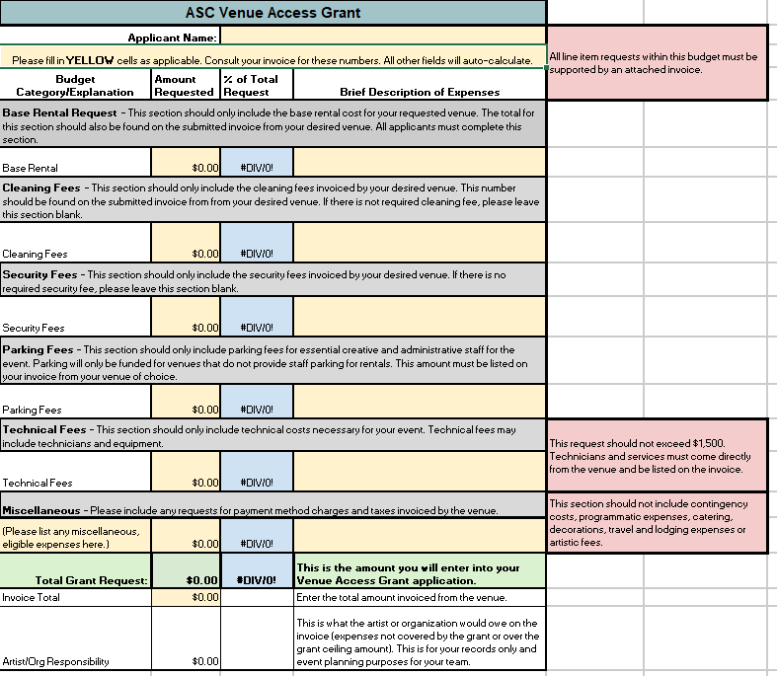
Budget
Please click here for the budget template for the Venue Access Grant
Supporting Documents
This budget template must be completed and submitted along with the invoice from your desired venue.
Any applications that are submitted without the template or supporting documents will not move forward in the review process.
Technical fees
Technical fees may include technicians and equipment.
Cost may not exceed $1,500
Technicians and services must come from the venue and must be listed in the invoice.

Slide 13
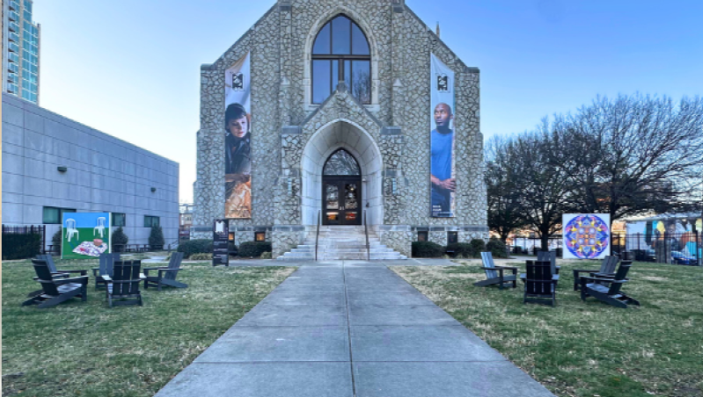
McColl Center
220 N Tryon, Charlotte, NC 28202

Slide 14
Additional Notes
Please see the list of confirmed Venue Access Grant Venues here.
Events must be completed and publicly performed between September 1, 2025, and December 31, 2026. For rentals that occurred in the past, ASC may make a retroactive reimbursement directly to the organization upon receiving a grant award.
Public and private venues are able to join the venue directory if they are interested. Priority will be given to organizations that seek a rental subsidy from a nonprofit venue that typically hosts arts, science, and history programming.
Participating universities (CPCC, UNCC, etc.) are able to join this venue directory if they are interested.
Participating churches are able to join this venue directory if they are interested. However, the performances in these spaces cannot contain religious content.
Union venues are currently not eligible.

Slide 15
PAGE 4
Requirements for Venue Use & Liability
Applicants must understand the following requirements related to venue rental and event execution:
MOU or contract with Venue: A signed contract between the applicant and the venue clearly outlining rental dates, times, costs, and services provided is a mandatory requirement to apply for this grant. This MOU or contract is created by each venue individually.
Venue Contract Relationship: ASC will have no liability under the contract between the applicant and the venues. All contracts are made between these two parties directly (applying organizations and the venue of their choosing). This Venue Access Grant only serves to reimburse organizations for these direct venue expenses.
Declined Grant Applications: If applicant does not receive a grant, applicant should inform the venue. If applicant does not reach out with this update, the venue may not be able to refund a deposit or any previously paid rental payments.

Slide 16
Venue Partnerships
Applicant Overview
a. General information for applicant (contact info, address, business type, etc.)
b. Applicant artistic mission statement (optional)
c. Link to portfolio (if available):
d. Artistic concentration area of event – (This will be a dropdown).
e. Project Title – (maximum two sentences)
f. Key Staff Involved: Describe qualifications and achievements of the key artistic personnel, including yourself, who are central to the event’s success.
Signed MOU or contract from Venue that includes proof of availability with chosen venue.
Accessibility Plan (optional): Document outlining a plan detailing how the event and chosen venue will be physically and programmatically accessible to individuals with disabilities, in compliance with ADA standards. In the spirit of equity, we want all people to be able to enjoy your event, though we understand that not all venues on our provided list are ADA-compliant. If applicant needs assistance to improve event accessibility, we encourage you to review the North Carolina Arts Council’s Accessibility Checklist.

Slide 17
Application Components
Narrative Questions:
A. Past Experience: Describe in detail at least one successful event that the applicant has previously produced in the last two years that exemplifies relevance, innovation, and top-level mastering of logistics needed. What made this event impactful?
i. Event Date:
ii. Program Title:
iii. Venue (within Mecklenburg County):
iv. Number of attendees:
v. Name of Venue’s Site Lead:
iv. Phone Number of Venue’s Site Lead:
iiv. Email of Venue’s Site Lead:
iiv. Note: ASC reserves the right to reach out to this previous venue as a reference check to ensure the information shared is truthful and this rental experience was compliant with all standards set by the partnering venue.

Slide 18
Application Components
Event Vision & Bridging Access: Describe the cultural event(s) the applicant plans to host. What are the key logistical milestones for planning and executing this event at the proposed venue? How many events for which funding is being sought, and what are the intended outcomes for this event? How will utilizing this specific venue help the applicant build new bridges to audiences or communities, eliminating barriers to arts and culture creating and participation in Mecklenburg County?
Marketing & Engagement: Please describe the target audience, the strategy for engaging them, emphasizing how the choice of this venue facilitates broader participation, and how the applicant plans to estimate and market to achieve attendance goals.
a. What is the estimated attendance goal for this event?
b. Do you plan to send out a post-event survey? Yes/No
Artist Sustainability: Beyond the grant period, how will this experience uplift the applicant’s artistic work, promote success, and influence long-term programming and sustainability for their business?

Slide 19
Application Components
Rental Budget & Documentation
a. Budget Template: Applicants submitting applications after March 11th are required to complete the Venue Access Grant budget template. They will also need to combine all supporting invoices to the budget before uploading.
b. Budget Questions:
i. Estimated revenue generated as an artist within the last 12 months before application submission date. (for creative individuals)
ii. Operating budget from the previous fiscal year. (for nonprofits)
iii. Amount of total rental expense.
iv. Requested subsidy (based on matrix)
c. Provide any additional details that are important to share with panelists when they review this quote.

Slide 20
Evaluation Criteria
Past Experience (25%): Applicant has a strong background in event planning and better skill set to execute this project based on this experience.
Feasibility (25%): The applicant's ability to successfully execute the proposed event at the chosen venue, as demonstrated by the project plan, budget, required documentation (insurance, contract), and safety/accessibility plans. All evidence points to this venue being an appropriate, beneficial location for the planned event.
Community Access (25%): How well the proposed event and venue choice demonstrate a clear potential to expand equitable access to arts, science, or history experiences for diverse communities in Mecklenburg County, including the projected audience size and reach.
Event Relevance (25%): The overall quality, integrity, and innovation of the event's content and its alignment with the organization's mission.

Slide 21
Reporting
All grantees will be required to submit a final report that describes the impact and outcome of the project.
Final reports must be filed through the online process within 30 days of the event’s completion.
Final reporting will ask about event attendance, impact observed, and ways to improve upon the event in the future.
  Additionally, this will include a digital survey sent to the site lead at the respective venue via ASC directly. This ensures that ASC selects organizations that present professionally and are strong partners with these eligible venues. A negative survey from a venue site lead can affect future availability for an organization to receive this grant.

Slide 22
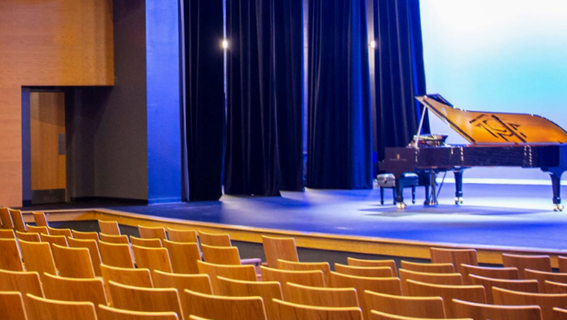
Parr Center, Theater
1201 ELIZABETH AVENUE, CHARLOTTE, NC 28204

Slide 23
Venue Access Grant Timeline
Application opens: Wednesday, January 14th, 2026, at noon
Supporting programming taking place September 1st, 2025 through December 31st , 2026
Application Deadline: Applications will be accepted on a rolling basis until May 4th, 2026 or until funds are exhausted.
Please submit draft applications to grants@artsandscience.org.
Award or Declination Notification: TBD. Applicants may expect notification approximately 4 weeks after application receipt.

Slide 24
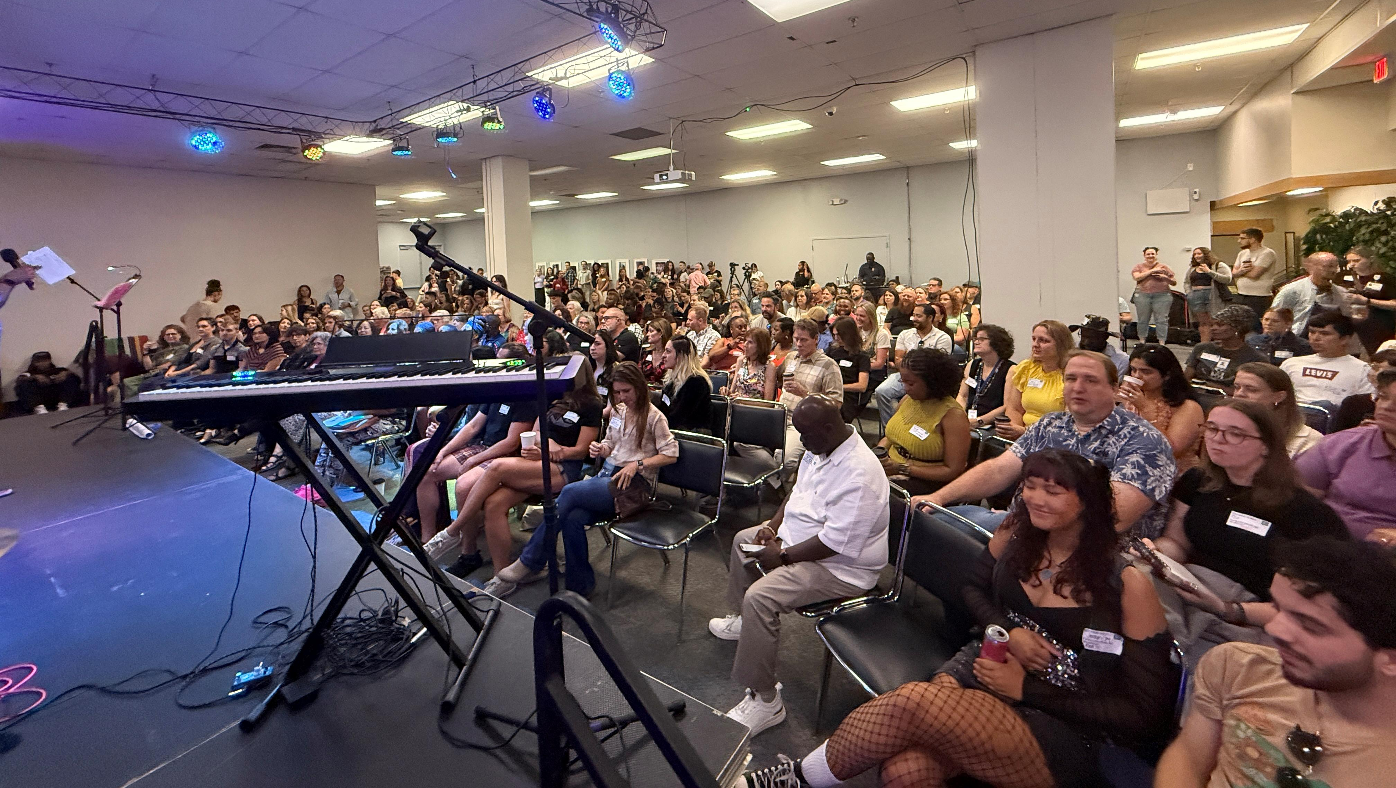
VAPA Center
700 N Tryon St, Charlotte, NC 28202
THANK YOU! QUESTIONS?

