Slide 1
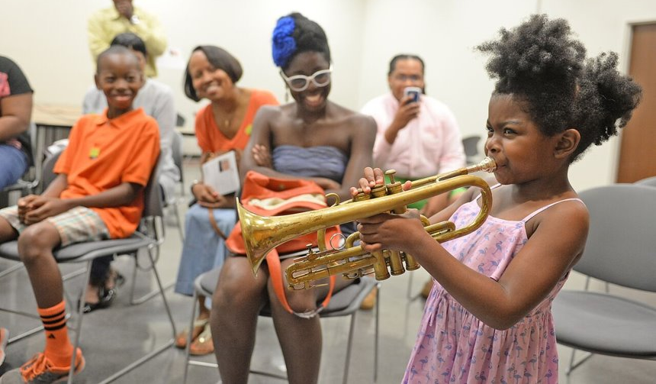
FY24 Providers Info Session Meeting

Slide 2
About ASC
Since 1975, a Public-Private Partnership
North Carolina Arts Council
City of Charlotte
Mecklenburg County
Towns
Private Donors – Corporate, Foundation & Individuals
Fund – Arts, Science, History organizations, Non-profit organizations and Creative Individuals
Mission: Investing in people, programs and ideas that move us to a more equitable, sustainable and innovative creative ecosystem.
Vision: An equitable, connected community where creativity is central, celebrated and supported.

Slide 3
Our Donors

Slide 4
Our Donors
Wells Fargo
Lowe's
Moore & Van Allen
Harris Teeter
Barnhardt Manufacturing
Canopy Realtor Association

Slide 5
Our Donors – Workplace Giving Campaigns
Wells Fargo
Atrium Health
Duke Energy
Bank of America
Moore & Van Allen
Parker Poe
Harris Teeter
Novant Health
UNC Charlotte

Slide 6
Our Commitment to Equity
TO TRULY ACHIEVE ASC’S VISION OF “CULTURE FOR ALL,” ALL CHARLOTTE-MECKLENBURG RESIDENTS MUST HAVE EQUITABLE OPPORTUNITY TO PARTICIPATE IN THE CULTURAL LIFE OF OUR REGION AS AUDIENCES, VOLUNTEERS, ARTISTS, ADMINISTRATORS, BOARD MEMBERS AND DONORS.
Equity in ASC’s Grant Making
Increase support for individual artists
Community Panel Review
Provide support through info sessions, office hours, and draft reviews
Feedback loop
Notes:
To practice this commitment to culture equity in our grant making, ASC has increased support for individual artists and engaged community grant review panels that reflect the diversity of our county and cultural sector. We provide opportunities for support applicants throughout process with info session, office hours and draft review, and provide feedback after the application process is concluded.

Slide 7
FY22 & FY23: $3.2 Million Invested in Creative Individuals
Community Programs
Cultural Education in Schools
Direct investment in Their Creative Practice

Slide 8
FY22 & FY23: $3.6 Million Invested in Organizations
Community Programs
Cultural Education in Schools
Capacity Building opportunities

Slide 9
FY22 & FY23 Investments
Individuals
73% of funds invested in BIPOC* Creatives
53% of funds invested in Black Creatives
11% of funds invested in LGBTQIA+ Creatives
Organizations
33% ALAANA** Organizations
12% have a mission Science, Nature, History
13% of recipients are Social Services/Community Organizations
*Acronym that references Black, Indigenous, and People of Color. **Acronym that references people of African, Latin-a/o/x/e, Asian, Arab, and/or Native American descent and organizations whose primary intentions, practices and missions are by, for and about ALAANA artists, cultures and communities.

Slide 10
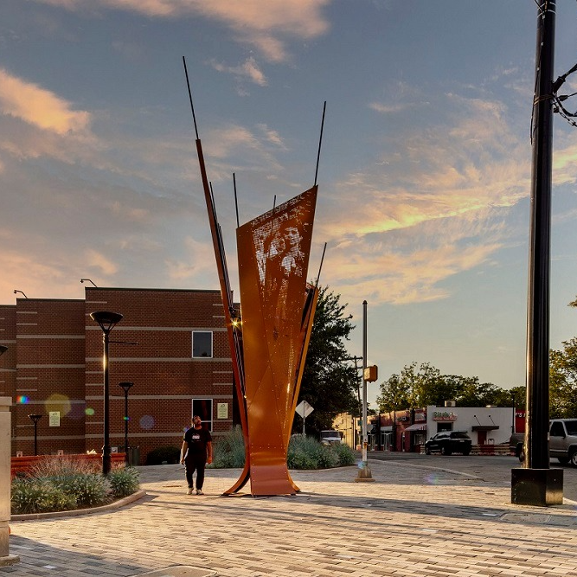
FY22 Public Art: 35 projects, $8.97m investment
City of Charlotte
Mecklenburg county
Charlotte Douglas International Airport
Excelsior | Stacy Utley & Edwin Harris
Five Points Plaza
Notes:
ASC also managed public art programs for the City of Charlotte, Mecklenburg County and the Charlotte Douglas International Aiport. The 35 projects ASC managed last fiscal year represent a total investment of 8.97m in Charlotte-Mecklenburg’s cultural landscape

Slide 11
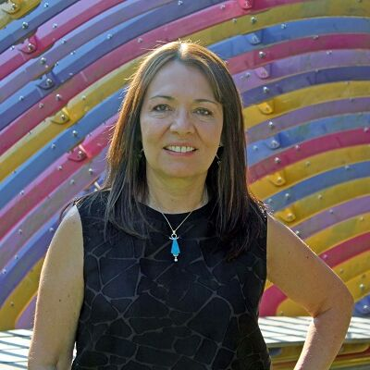
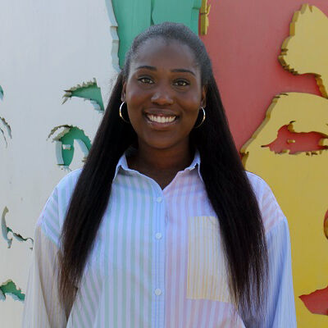
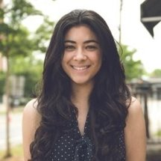
CULTURE BLOCKS TEAM
Claudia Gonzalez Griffin
Program Director
Brooklyn Miller
Program Manager
Giovanna Torres
Marketing Liaison

Slide 12
PURPOSE
ASC Culture Blocks connects communities with responsive arts, science, and history experiences closer to where residents live. The program engages with creative individuals and organizations with a primary mission of arts, science, and/or history to present programs in specific geographic areas.
Culture Blocks, funded by Mecklenburg County, supports cultural experiences planned with resident involvement and/or at libraries, recreation centers, parks, and relevant community spaces.

Slide 13
WHAT IS CULTURE BLOCKS?
Culture Blocks presents arts, science, and history experiences in neighborhoods across Mecklenburg County.
Culture Blocks programs are often interactive, inviting residents to engage directly in arts, science, and history experiences.
The programs are presented primarily using Charlotte-Mecklenburg Libraries, and Mecklenburg County Parks and Recreation Centers facilities.
The programs take place within designated geographic areas, including neighborhoods in Charlotte, and the towns of Cornelius, Huntersville, Davidson, Matthews, Mint Hill and Pineville.
Programs may include concerts, dance and theatre experiences, visual arts workshops, history programming, or opportunities for the community to engage with the natural world through science and technology.
Community is key!

Slide 14
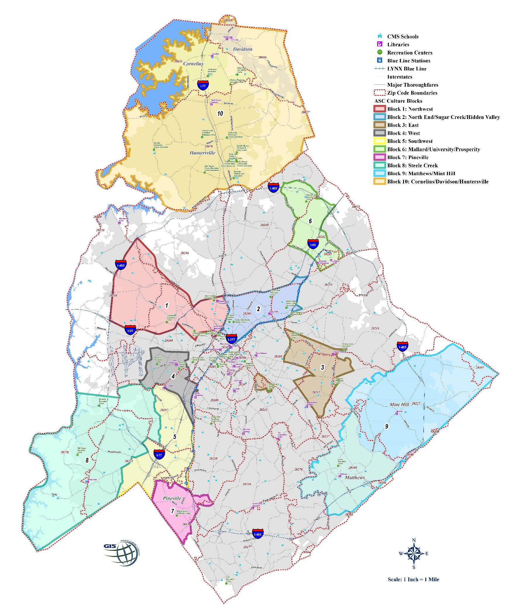
10
6
1
2
Programming must be geared toward residents living in one or more of the designated
geographic areas and increase access to creative experiences.
3
4
9
5
8
7

Slide 15
COMMUNITY FEEDBACK
Resident engagement and feedback is key to the Culture Blocks Program. ASC Staff hosts engagement events in each Block to collect feedback from residents. This feedback is compiled and made available to applicants. Ideal Culture Blocks providers have a track record of engaging Mecklenburg County residents in their creative practice.
Neighborhood meetings & events
ASC hosted gatherings & facilitated discussions
Individual conversations
Virtual Block Parties
Compelling applications for Culture Blocks funding are informed by the community feedback and make clear connections between the community feedback and the programming they plan to offer the community.
All applications must align with these themes located in the Community Feedback Document

Slide 16
HOW DOES CULTURE BLOCKS FUNDING CALL WORK?
Individuals and non-profit organizations
Arts, science, and history programming delivered directly to residents.
Primarily leveraging Rec Centers and Libraries, or other community spaces
ASC is paying artists and non-profit organizations directly to support this programming
Culture Blocks intends to fully fund the direct expenses related to the delivery of these programs. As such, Culture Blocks programs are provided to the community at no charge to the public

Slide 17
OTHER FUNDING OPPORTUNITIES
Please note: Culture Blocks funding is not designed to help an artist or organization with start-up funding or capacity-building support. ASC offers other funding opportunities, such as Artist Support Grants, Cultural Vision Grants, and Cultural Organization Support Grants to support these efforts. ​
RETURNING PROVIDERS
Returning Culture Blocks providers should note that receiving support in the past is not a guarantee of future support. It is necessary on the applicant to provide sufficient context and detail for the review panel to agree to support a new application.

Slide 18
GUIDELINES APPLICATION INSTRUCTIONS
Notes:
The program title used in the narrative is the title used on ASC website (please make sure you choose an accurate program title and this is the same title on CCG and your marketing)
Assistance with CCC: the email address is….
For when rescheduled programs occur, we strongly encourage proving a contact # that is not the venue on all promotional content.
Now is the time to develop a plan for how you are going to submit accurate & quality reports

Slide 19
TIMELINE
APPROVAL OR DECLINATION NOTIFICATION
Deadline: February 19, 2024, at NOON EST.
Late applications will not be accepted.
Fee: Free
Programming must take place: Between July 1, 2024 – September 30, 2024.
Applicants will be notified of approval or declination on or around March 28, 2024.
Begin an application by visiting https://artsandscience.org/culture-blocks-creative-individuals/
*** An additional call for funding will open in the Summer of 2024 to support experiences presented between October 1, 2024, to December 31, 2024. ***

Slide 20
INFO SESSIONS
Tuesday, January 16, 2024, at 3 p.m. Register here.
Tuesday, January 30, 2024, at NOON. Register here.
Tuesday, February 13, 2024, at 2 p.m. Register here.
REVIEW DRAFT APPLICATIONS AND BUDGETS
January 22 to February 9 by NOON – Applicants are to send draft applications and Budgets to cultureblocks@artsandscience.org
15-minute meetings
February 12-16 Use the following link to schedule meetings: 15-minute Meetings
Email grants@artsandscience.org with technical questions.

Slide 21
WHO CAN APPLY
Creative individuals
Organizations
Collaborative programming is welcomed. Organizations working together must identify a single organization to serve as the applicant.
Religious organizations and institutions of higher education can apply provided the programming reaches a broader audience (not only church membership or faculty/student body) and does not contain proselytizing religious content.
Neighborhood organizations are welcome to apply.

Slide 22
AVAILABLE FUNDING REQUEST AMOUNT
The total requested amount should not exceed $35,000.
Your budget and program scope should align with your funding request. Make sure to refer to the RESTRICTIONS.
Requests to support an organization’s ongoing staff or faculty salaries are not eligible.
Capital expenses, operating expenses (staff salaries, budgeted marketing expenses, etc., annual product licenses, membership fees, web hosting fees, investment in technology or software) are NOT eligible expenses.
Advertising and Communication Costs should not exceed 15% of the total project budget.
A 15% admin fee will be applied to your budget automatically in the budget to help cover administrative costs related to the project.
*You must use the Culture Blocks Excel budget template provided to add program expenses. Failure to use the provided template will disqualify an application.*

Slide 23
BUDGET
*You must use the Culture Blocks Excel budget document provided to add program expenses. Failure to use the provided template will disqualify an application.*
Get estimates ahead of application submission:
Fees for contracted work (teachers, graphic designers, etc.) be specific how many programs, teachers and pay by hour.
Marketing materials
Supplies
Notes:
The program title used in the narrative is the title used on ASC website (please make sure you choose an accurate program title and this is the same title on CCG and your marketing)
Assistance with CCC: the email address is….
For when rescheduled programs occur, we strongly encourage proving a contact # that is not the venue on all promotional content.
Now is the time to develop a plan for how you are going to submit accurate & quality reports

Slide 24
SELECTION CRITERIA
FEASIBILTY: There is compelling evidence that the organization and/or creative individual can carry out this program effectively. The applicant has provided sufficient detail for the panel to determine that the applicant can deliver this program to the public if their application is selected.
MISSION ALIGNMENT: There is compelling evidence that this proposal aligns with the spirit of the funding opportunity, i.e. to provide engaging arts, science, and history programming to Charlotte-Mecklenburg residents.
COMMUNITY ENGAGEMENT: There is compelling evidence that this proposal aligns with the interest of the community the applicant seeks to engage in; the proposal specifically leverages the community feedback provided in the guidelines.
MARKETING AND COMMUNICATIONS: There is compelling evidence that this applicant has a clear marketing plan to reach the community their program intends to serve; relevant marketing expenses are specified in the budget.

Slide 25
PROGRAM SUBMISSION PLAN
Read the guidelines and the Community Feedback Document
Create the Program
Select the Block(s) where the program will be offered and select the facility. Find the Parks, Rec Centers, and Libraries contacts in the Facilities Document
Contact Facilities contact staff and offer the program. If they agreed to host the program, ask them to complete the Facility Host Agreement
Program submissions should be planned with details (including timeline/dates, staff/team, budget, etc.). Ideas without accompanying details will not be funded.
Panelists need to have a clear understanding of what the participant experience will look like.

Slide 26
WHAT QUALIFIES FOR CULTURE BLOCKS FUNDING
Programing should take place between July 1 and September 30. 2024
The program is an arts, science, history, or heritage project that takes place in a Culture Blocks designated Geographic Areas.
Programming should align with Culture Blocks Themes. Follow this link to review the themes each Culture Block has identified. Community Feedback.
One-time programs and/or recurring programs are eligible.
An applicant can offer programming in multiple blocks or one culture block location.
Programming should directly engage residents.
Programs must be free and open to the public.

Slide 27
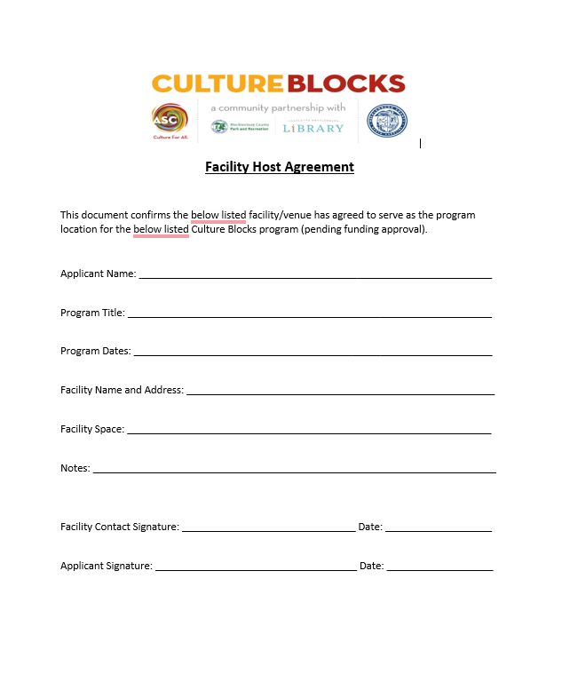
FACILITIES HOST AGREEMENT
You must submit the facility host Agreement with the application.
Applications submitted without this form will not be considered for funding. No exceptions will be made.
Find it in this link
Notes:
The program title used in the narrative is the title used on ASC website (please make sure you choose an accurate program title and this is the same title on CCG and your marketing)
Assistance with CCC: the email address is….
For when rescheduled programs occur, we strongly encourage proving a contact # that is not the venue on all promotional content.
Now is the time to develop a plan for how you are going to submit accurate & quality reports

Slide 28
RESTRICTIONS
Culture Blocks funding intends to support the direct expenses of a creative individual or non-profit organization to deliver a program. Prior to applying, please consider the following list of requests that are not supported:
Programming that involves work with PreK-12 children during the school day is not eligible.
Programming designed to serve as a fundraiser is not eligible.
Programming that occurs outside of Culture Block’s Blocks is not eligible.
Organizations or individuals with delinquent paperwork for a previously funded ASC grant in the last five (5) years are not eligible to apply.
Requests for capital expenditures or purchase of new equipment are not eligible (e.g. laptops, digital cameras, kilns, sewing machines, instruments).
Applicants may not budget for lost revenue, or to offset income.
Culture Blocks does not fund mileage or mileage reimbursement. Rental of a vehicle to transport large items (e.g., equipment, props, etc.)
Culture Blocks funds cannot be used for temporary lodging or airfare.
Notes:
The program title used in the narrative is the title used on ASC website (please make sure you choose an accurate program title and this is the same title on CCG and your marketing)
Assistance with CCC: the email address is….
For when rescheduled programs occur, we strongly encourage proving a contact # that is not the venue on all promotional content.
Now is the time to develop a plan for how you are going to submit accurate & quality reports

Slide 29
RESTRICTIONS
Ongoing operating expenses, including staff salaries and benefits, annual product licenses, membership fees, web hosting fees, etc., are not eligible expenses. Fees to artists or contractors hired specifically to deliver the program are eligible.
Costumes and props are not generally funded. However, reasonable exceptions may be considered up to 10% of the total program budget request on a case-by-case basis.
Food and beverages are not generally funded. However, reasonable exceptions may be considered such as snacks for afterschool youth programs or water for a movement-based experience such as dance.
Culture Blocks is designed to leverage public facilities in the designated geographies, and as such many public facilities are available to the applicant free of charge. We do accept applications in other spaces; however, applicants should note that significant rental fees may pose a challenge to a successful application.
Notes:
The program title used in the narrative is the title used on ASC website (please make sure you choose an accurate program title and this is the same title on CCG and your marketing)
Assistance with CCC: the email address is….
For when rescheduled programs occur, we strongly encourage proving a contact # that is not the venue on all promotional content.
Now is the time to develop a plan for how you are going to submit accurate & quality reports

Slide 30
APPLICATION QUESTIONS
Applicant Information
This section is intended to provide relevant context about you to the panel. The information included here should be relevant to the project proposal and highlight how you engage the community through your creative practice.
Applicant Contact Information
Leadership Contact Information
Primary Contact Person
Provider County District Number
Provider City District Number
W-9
Notes:
The program title used in the narrative is the title used on ASC website (please make sure you choose an accurate program title and this is the same title on CCG and your marketing)
Assistance with CCC: the email address is….
For when rescheduled programs occur, we strongly encourage proving a contact # that is not the venue on all promotional content.
Now is the time to develop a plan for how you are going to submit accurate & quality reports

Slide 31
APPLICATION QUESTIONS
Applicant Snapshot
Please state the mission and/or vision of the Organization or an artist statement.
Describe your leadership model and who leads your work. Help us understand who the primary decision makers are and why they are qualified to do this work. For organizations, this could include your executive director, senior leadership, board, and/or other leaders. For individual applicants, provide some context for your creative practice and/or key collaborators.
Please describe relevant public programming you have offered or relevant experience providing arts/culture/science programming to the public.
How do you seek to engage the community through your creative practice? For organizations, this may include engagement with distinct populations in alignment with your mission statement. For individual creatives, identify how working with different communities across Mecklenburg County enhances your creative practice. How do you bring the community into your work?
Notes:
The program title used in the narrative is the title used on ASC website (please make sure you choose an accurate program title and this is the same title on CCG and your marketing)
Assistance with CCC: the email address is….
For when rescheduled programs occur, we strongly encourage proving a contact # that is not the venue on all promotional content.
Now is the time to develop a plan for how you are going to submit accurate & quality reports

Slide 32
APPLICATION PROGRAM INFORMATION 1
In the following section, applicants should outline their proposed program. Proposals should be informed by the COMMUNITY FEEDBACK DOCUMENT and provide a clear vision for how the program will be delivered to their intended audience. It is incumbent on the applicant to provide sufficient detail for the panel to determine the program is aligned to the spirit of Culture Blocks.
Program Title Please use this format: To support Org’s Program Title on Date at Location/Block #. OR To support Org’s Program Title from (mm/yyyy) – (mm/yyyy) at Location/Block #.
Program Start Date
Program End Date
Programming that also addresses the County Identified Critical Access needs listed below is encouraged. If your project aligns with the County Critical Access needs, please identify which ones below.
Please indicate the Culture Block where your program will occur.
.
Notes:
The program title used in the narrative is the title used on ASC website (please make sure you choose an accurate program title and this is the same title on CCG and your marketing)
Assistance with CCC: the email address is….
For when rescheduled programs occur, we strongly encourage proving a contact # that is not the venue on all promotional content.
Now is the time to develop a plan for how you are going to submit accurate & quality reports

Slide 33
APPLICATION PROGRAM INFORMATION 2
Please list the dates, times, locations, and number of participants expected in each program. List as bullet points and use this format:
Marion Diehl Recreation Center, 2219 Tyvola Road, Charlotte, NC28210 May 2, 7, 15. June 5, 8, 15 from 1:00 to 3 pm. 30 Participants each day.
Describe/Outline the program. What will the community experience from this program?
Please indicate the community theme(s) to which your program responds. You may select up to 5.
Describe the intended audience experience. What do you want the community to take away from this experience? (250 words)
How does your program align to the community feedback for the block(s) you will be working in? How does the community feedback inform your proposal? (250 words)
Please indicate the total number of participants you expect to engage with during the project.
Notes:
The program title used in the narrative is the title used on ASC website (please make sure you choose an accurate program title and this is the same title on CCG and your marketing)
Assistance with CCC: the email address is….
For when rescheduled programs occur, we strongly encourage proving a contact # that is not the venue on all promotional content.
Now is the time to develop a plan for how you are going to submit accurate & quality reports

Slide 34
APPLICATION PROGRAM INFORMATION 3
Culture Blocks is a partnership between ASC, Charlotte-Mecklenburg Library, and Mecklenburg County Parks and Recreation. Public facilities are available in each Block as venues for the Culture Blocks Programs and without cost. If you are using a Library or Rec Center, how did you choose this facility? If you are not using a Library or Rec Center, why did you choose this space, and how does using this facility enhance the experience of the participants? (250 words)
Which age groups are your programs suitable for?
Provide a list of the administrative and creative staff involved in delivering the program and a brief description of their contributions. This should include any paid or volunteer leaders responsible for executing the program. Name each individual, provide a brief description of the experience/expertise they are contributing and their connection to your intended audience. (Word limit 500)
Notes:
The program title used in the narrative is the title used on ASC website (please make sure you choose an accurate program title and this is the same title on CCG and your marketing)
Assistance with CCC: the email address is….
For when rescheduled programs occur, we strongly encourage proving a contact # that is not the venue on all promotional content.
Now is the time to develop a plan for how you are going to submit accurate & quality reports

Slide 35
APPLICATION PROGRAM INFORMATION 4
Marketing Overview: Outline the communications and promotions plan and timeline for the program. How do you plan to promote and spread the word about this project? Please include any details about marketing expenses you have included in the budget. (Word limit 500)
Facility Host Agreement. If your team is using multiple venues, please upload all of the forms as 1 document/pdf.
Budget Template. Applicants must use the template provided in the application guidelines. Failure to do so will disqualify an application.
Describe how your team determined the budget you have included in this application. (Word limit 250).
Notes:
The program title used in the narrative is the title used on ASC website (please make sure you choose an accurate program title and this is the same title on CCG and your marketing)
Assistance with CCC: the email address is….
For when rescheduled programs occur, we strongly encourage proving a contact # that is not the venue on all promotional content.
Now is the time to develop a plan for how you are going to submit accurate & quality reports

Slide 36
MARKETING REQUIREMENTS
If you are approved for funding, there are marketing requirements for you to use to promote your program/event. New and previous providers will/must attend a marketing session. You must acknowledge Culture Blocks as a sponsor.
Culture Blocks Logo
Charlottecultureguide.com
Text-free image
Example of marketing materials (flyers, social media images, virtual flyers, etc.)
Notes:
The program title used in the narrative is the title used on ASC website (please make sure you choose an accurate program title and this is the same title on CCG and your marketing)
Assistance with CCC: the email address is….
For when rescheduled programs occur, we strongly encourage proving a contact # that is not the venue on all promotional content.
Now is the time to develop a plan for how you are going to submit accurate & quality reports

Slide 37
PAYMENTS
If elected, your payments will be given in installments.
Payment schedules will vary, depending on both the scope and duration of the contracted programming.
Submission of initial paperwork will be required for a first installment.
Final report submission will be required before final payments are made.
For organizations applying to partner with a creative individual or cultural organization, ASC will provide the fees and payment schedule to the program provider.
Notes:
The program title used in the narrative is the title used on ASC website (please make sure you choose an accurate program title and this is the same title on CCG and your marketing)
Assistance with CCC: the email address is….
For when rescheduled programs occur, we strongly encourage proving a contact # that is not the venue on all promotional content.
Now is the time to develop a plan for how you are going to submit accurate & quality reports

Slide 38
Upon Funding Approval:
Read the Memorandum of Understanding (MOU), Marketing Toolkit, and Funding Schedule.
Upload signed MOU to an online account.
Upload signed W-9 to an online account.
Upload a copy of the marketing materials with the correct logo.
Upload a text-free image.
Submit programs to Charlotte Culture Guide (note ASC Culture Blocks sponsorship)
Notes:
The program title used in the narrative is the title used on ASC website (please make sure you choose an accurate program title and this is the same title on CCG and your marketing)
Assistance with CCC: the email address is….
For when rescheduled programs occur, we strongly encourage proving a contact # that is not the venue on all promotional content.
Now is the time to develop a plan for how you are going to submit accurate & quality reports

Slide 39
REQUIRED REPORTING
You must submit a Monthly Report and use the provided document. It will be sent to you at the end of each month, and you will need to return it by the first 5 business days of the month.
You must submit a Final Report at the end of the program using the document provided. You will have 2 weeks to complete it.
You must submit a Final Expenses Report using the document provided.
You must track the participation #s for each of the events and programs.
Program Title/Name of Program
# of days activated/# of times offered and location
# of attendees/views
How the program was delivered (Eg. Zoom, Facebook Live, etc.)
Quotes from participants and/or providers
List of participants registered with contact information
Notes:
Use the key provided at the top of the template. We only accept this template at this time.
Add a disclaimer on your registration, sign-up sheets, or post event survey stating contact data is shared with ASC.
We are interested in participant feedback. Facility feedback can be included on your final report.

Slide 40
FINAL REPORT AND BUDGET REPORT
Upon Program Completion: Submit Final Report & Budget
Actual expense budget
Final reflection on program execution
Quotes from participants and/or providers
List of participants registered with contact information
Program Photos/Screenshots
Notes:
ASC staff will send an email when the final report is due and we will include the Request ID # which is also on your MOU to assist distinguish reports for those who have more than 1 program taking place. This is an opportunity to reflect on the initial plan and how it went. We ask for actual program photos. These final reports and interim reports contribute to ability to contract in the future. *Changes to final report look will take place after December 2018.

Slide 41
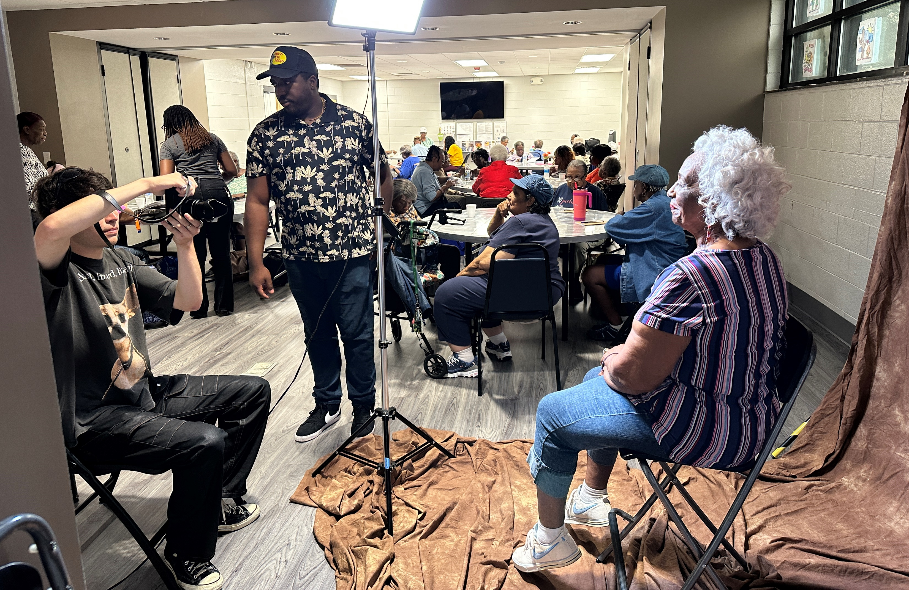
Light Factory Program (2023)
West Charlotte Recreation Center in Block 1.

Slide 42
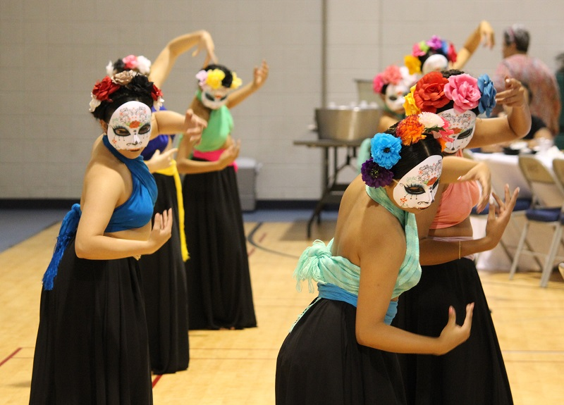
THANK YOU

